Slide 1
Symantec kernel and RAG
Presented by:
Mohamed Saied

Slide 2
Agenda
What is Semantic Kernel?
Tools, Plugins, and Function Calling
Understanding the Tool-Calling Loop
From Function Calling to Agent Behavior
What is RAG and Why Do We Need It?
Embeddings and Vector Representations
Vector Similarity Search
RAG Pipeline and Execution Flow
Practical Application Architecture
Multi-Step Workflow Demo
Key Takeaways

Slide 3
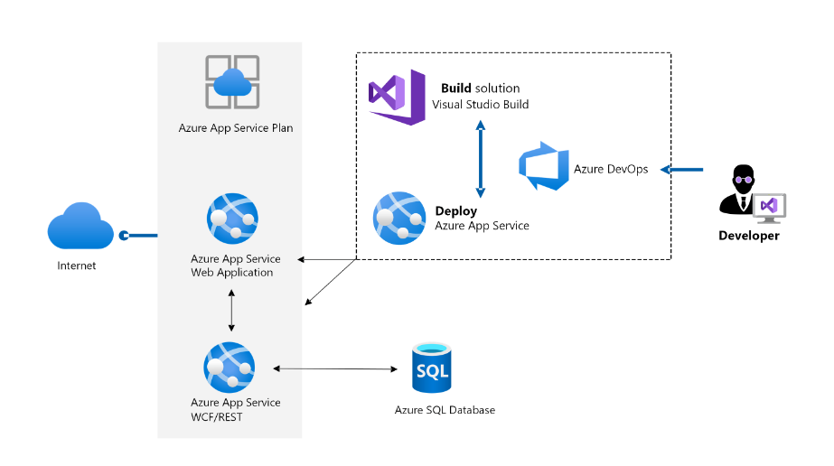
Symantec Kernel
Definition :
A free, open-source library from Microsoft for building AI apps in C#, Python and Java.
It connects our code to an AI model (Azure OpenAI, OpenAI and others).
It handles the boring parts: tools, chat history, and calling the model again and again.
Think of it as the glue between the model and our application.

Slide 4
App Service Plan
An App Service plan defines a set of compute resources for a web app to run. One or more apps can be configured to run on the same computing resources (or in the same App Service plan).
Operating System (Windows, Linux)
Region (West US, East US, etc.)
Number of VM instances
Size of VM instances (Small, Medium, Large)
Pricing tier (Free, Shared, Basic, Standard, Premium, PremiumV2, PremiumV3, Isolated, IsolatedV2)

Slide 5
App Service Plan
Shared compute: Free and Shared. | the two base tiers, runs an app on the same Azure VM as other App Service apps, including apps of other customers. These tiers allocate CPU quotas to each app that runs on the shared resources, and the resources can't scale out.
Dedicated compute(Basic, Standard, Premium, PremiumV2, and PremiumV3) | refers to the compute resources that are exclusively allocated to a specific app or a set of apps. These resources are not shared with other customers or apps, ensuring consistent performance and isolation
Isolated and IsolatedV2 | Azure VMs on dedicated Azure Virtual Networks. It provides network isolation on top of compute isolation to your apps.

Slide 6
Configure web app settings
Zone redundancy refers to redundancy within the same region but across different Availability Zones (which are physically separated data centers) in that region. It does not mean redundancy across multiple regions.
Application Insights is an Azure service that provides performance monitoring, diagnostics, and analytics for your applications (Auto instrumentation https://learn.microsoft.com/en-us/azure/azure-monitor/app/codeless-overview
Environment variables
Managed pipeline version:
  Classic Mode: . This means that the two pipelines (IIS and ASP.NET) are separate.
  Integrated Mode: ASP.NET becomes part of IIS itself, not just an add-on and middleware's are combine .

Slide 7
Configure web app settings
SCM Basic Auth Publishing Credentials refer to the credentials used for basic authentication when deploying applications to Azure App Service via methods such as Visual Studio, local Git, and GitHub
FTP Basic Auth Publishing Credentials refer to the authentication method used for deploying applications to Azure App Service via FTP
Path mappings section you can configure handler mappings, and virtual application and directory mappings. The Path mappings page displays different options based on the OS type.

Slide 8
Configure web app settings
Session affinity user cookie to talk spatial instance after scaling
There are situations where in keeping the affinity is not desired. For example, if you are getting way too many requests from a single user and the requests going to the same web server instance can overload it.
End-to-end TLS encryption ensures that data remains encrypted throughout its entire journey from the client to the server, preventing TLS termination at any intermediary point.
Client Certificate Mode is a security feature used in TLS where both the server and the client authenticate each other by exchanging certificates. This adds an extra layer of security
Client Certificate: The client must have a valid certificate issued by a trusted Certificate Authority (CA), which proves the client's identity to the server.

Slide 9
Configure web app settings
Configure security certificates
Option | Description
Create a free App Service managed certificate | A private certificate that's free of charge and easy to use if you just need to secure your custom domain in App Service.
Purchase an App Service certificate | A private certificate that's managed by Azure. It combines the simplicity of automated certificate management and the flexibility of renewal and export options.
Import a certificate from Key Vault | Useful if you use Azure Key Vault to manage your certificates.
Upload a private certificate | If you already have a private certificate from a third-party provider, you can upload it.
Upload a public certificate | Public certificates aren't used to secure custom domains, but you can load them into your code if you need them to access remote resources.

Slide 10
Deploy to App Service
Automated :is a process used to push out new features and bug fixes in a fast and repetitive pattern with minimal effect on end users Azure DevOps Services, or GitHub, Bitbucket).
Manual: (Git, CLI, Zip deploy, Zip deploy).
Continuously deploy code
Continuously deploy containers
Use deployment slots
  When using a Standard App Service Plan tier or better
  https://learn.microsoft.com/en-us/training/modules/understand-app-service-deployment-slots/3-app-service-slot-swapping

Slide 11
Deploy to App Service
If you use Local Cache enabled on each instance Local Cache in Azure App Service is a feature that allows application content to be stored in the local storage of each VM instance. This improves performance by reducing latency, as files are served from local storage rather than remote storage. When local cache is enabled, the app can initialize quickly after deployment or during a swap, resulting in faster response times and minimized cold start issues, enhancing the overall user experience.
Swap with Preview is a deployment strategy in Azure App Service that allows you to temporarily apply production settings to the staging slot before finalizing the swap. This two-phase process enables validation of the new code in the staging environment with production configurations, ensuring that the application operates correctly before it goes live. During this validation phase, you can test the app's functionality and performance, minimizing the risk of errors in production.
Automatic Slot Swaps You can configure an auto-swap for specific slots. This means that whenever you deploy to a non-production slot (e.g., staging), Azure will automatically swap the app into production after a successful deployment.
Route traffic in App Service: is a feature that allows you to seamlessly switch traffic between two deployment slots.

Slide 12
Deploy to App Service
Benefits of Deployment Slots:
  Zero downtime deployments: You can deploy new updates to a non-production slot, test them, and then swap
  the new changes to production.
  Easy rollback: If something goes wrong in production, you can immediately swap back to the previous version.
  Isolated testing: You can fully test the new version on the same resources as the production app before swapping

Slide 13
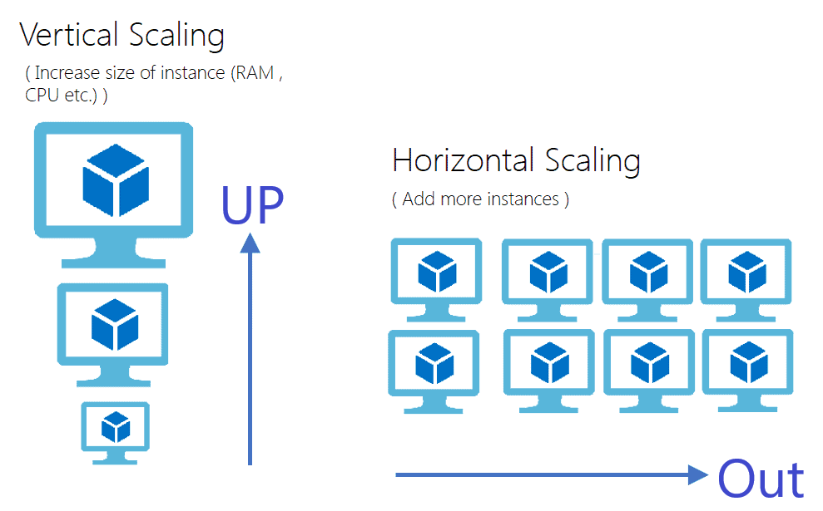
Scale Apps In Azure App Service
Scale up down:
  Acquiring more resources for an application,
  such as increasing CPU, memory, or disk space
  This is achieved by changing the pricing tier .
Scale in out :
  App Service plan is the scale unit of the App Service apps.
  If multiple apps are in the same App Service plan,
  they all share the same VM instances and share
  auto scaling if configured in it.

Slide 14
Scale Apps In Azure App Service
Type | Definition | Use case
Manual Scaling | Manually increasing or decreasing the number of instances (scaling out) or size (scaling up). | Predictable traffic or resource-intensive tasks like data processing that require more powerful VMs.
Auto-Scaling | Automatically adjusts the number of instances based on real-time metrics (e.g., CPU, memory usage). | you might expect increased/reduced activity for a business app during holidays. handling long-term growth.
Automatic Scaling | a new scale-out option that automatically handles scaling decisions for your web apps and App Service Plans, you can adjust scaling settings to improve your app's performance and avoid cold start issues | You don't want to set up auto-scale rules based on resource metrics. You want your web apps within the same App Service Plan to scale differently and independently of each other. Your web app is connected to a database or legacy system, which may not scale as fast as the web app. Scaling automatically allows you to set the maximum number of instances your App Service Plan can scale to. This setting helps the web app to not overwhelm the backend.

Slide 15
Scale apps in Azure App Service
Metrics for auto-scale rules
CPU Percentage, CPU Per centage, Http Queue Length, Data In ..etc
Auto scale actions
  time grain , Duration, aggregation
Combining auto scale rules
  the following four rules in the same auto-scale condition:
  If the HTTP queue length exceeds 10, scale out by 1
  If the CPU utilization exceeds 70%, scale out by 1
  If the HTTP queue length is zero, scale in by 1
  If the CPU utilization drops below 50%, scale in by 1
  OR between all scale out Rules together .
  AND between all scale in Rules together .
  The Default scale condition in Azure is executed when none of the other scale conditions are active because it serves as a fallback mechanism. This condition ensures that there is always a defined behavior for scaling

Slide 16
Scale apps in Azure App Service
Best practice
Ensure the maximum and minimum values are different and have an adequate margin between them.
minimum=2, maximum=>>, no scale action can occur
Choose the thresholds carefully for all metric types
  We don't recommend auto scale settings like the following examples with the same or similar threshold values for out and in conditions while :
  we have two instances running
  Increase instances by one count when Thread Count >= 600
  Decrease instances by one count when Thread Count <= 600
  What if when average Thread Count become 625 lead to adding Thread Count (scale out)
  Then average of all become 575 lead to scale in
  575*3(current threads count)/ 2 (num of instances after scale in)=862.5 lead to scale out again

Slide 17
Logging
Application Insights is an Azure service that provides performance monitoring, diagnostics, and analytics for your applications (Auto instrumentation :https://learn.microsoft.com/en-us/azure/azure-monitor/app/codeless-overview)
  The Microsoft.ApplicationInsights.Web NuGet package is used in .NET applications to enable Application Insights for web applications. Application Insights is an APM (Application Performance Management) service provided by Azure that helps developers monitor the (performance, Exception Tracking, User and Session Tracking, availability, and usage of their applications).
App Service Logs: Use when you want to debug application-specific issues like unhandled exceptions, request failures, or detailed server errors.

Slide 18
App Service Logs
Type | Platform | Location | Description
Application logging | Windows, Linux | App Service file system and/or Azure Storage blobs | Logs messages generated by your application code.
Web server logging | Windows | App Service file system or Azure Storage blobs | Raw HTTP request data in the W3C extended log file format. Each log message includes data like the HTTP method, resource URI, client IP, client port, user agent, response code, and so on.
Detailed error messages | Windows | App Service file system | Copies of the .html error pages that would have been sent to the client browser.
Failed request tracing | Windows | App Service file system | Detailed tracing information on failed request s, including a trace of the IIS components used to process the request and the time taken in each component. One folder is generated for each failed request, which contains the XML log file, and the XSL stylesheet to view the log file with.
Deployment logging | Windows, Linux | App Service file system | Helps determine why a deployment failed. Deployment logging happens automatically.

Slide 19
Logging
Diagnostics Settings: Use when you want broader visibility into Azure-level metrics and logs, You need insights into how the Azure infrastructure (e.g., the underlying VM, scaling actions, or resource health).
-Your application involves multiple services (like App Service, Azure Functions, SQL Databases), and you need to trace requests across all these services to understand where performance bottlenecks are occurring.
Antivirus Audit logs : Virus detection, quarantined files, scanning results, or any modifications to antivirus settings.
HTTP Logs : Unusual or failed HTTP requests, changes in endpoints accessed, and variations in HTTP methods or statuses.
App Service Console Logs : Debugging information, application-level errors, or runtime issues output to the console.

Slide 20
Service networking features
Free and Shared SKU Plans: Free and Shared pricing tiers are the most basic and are ideal for testing projects or small-scale projects, Multitenant Workers: In these tiers, your app runs on shared infrastructure. This means the underlying server or "worker" is shared by multiple customers,
Basic and Higher Plans (Standard, Premium, etc.):Your apps no longer run on shared resources; instead, they have a dedicated worker (server instance) for all apps within the same App Service plan.

Slide 21
Service networking features
Feature | Type | Description
App-assigned address | Inbound | A unique IP address or domain name assigned to your app, allowing it to receive requests.
Access restrictions | Inbound | Controls which IP addresses or ranges can access your app, allowing for trusted source limitations.
Service endpoints | Inbound | Provides secure access to Azure services like Azure Storage or SQL Database, keeping traffic within Azure's network.
Private endpoints | Inbound | Allows access to Azure services over a private IP within your Virtual Network, ensuring traffic doesn't go through the public internet.
Hybrid Connections | Outbound | Establishes secure outbound communication between your app and on-premise or non-Azure services via a secure tunnel.
Gateway-required virtual network integration | Outbound | Allows your app to connect to resources in a Virtual Network using a VPN gateway for secure outbound communication.
Virtual network integration | Outbound | Standard integration that enables secure communication between your app and resources in the same or peered Virtual Networks without a gateway.

Slide 22
References
https://learn.microsoft.com/en-us/training/paths/create-azure-app-service-web-apps/

Slide 23
Thank You

